Slide 1
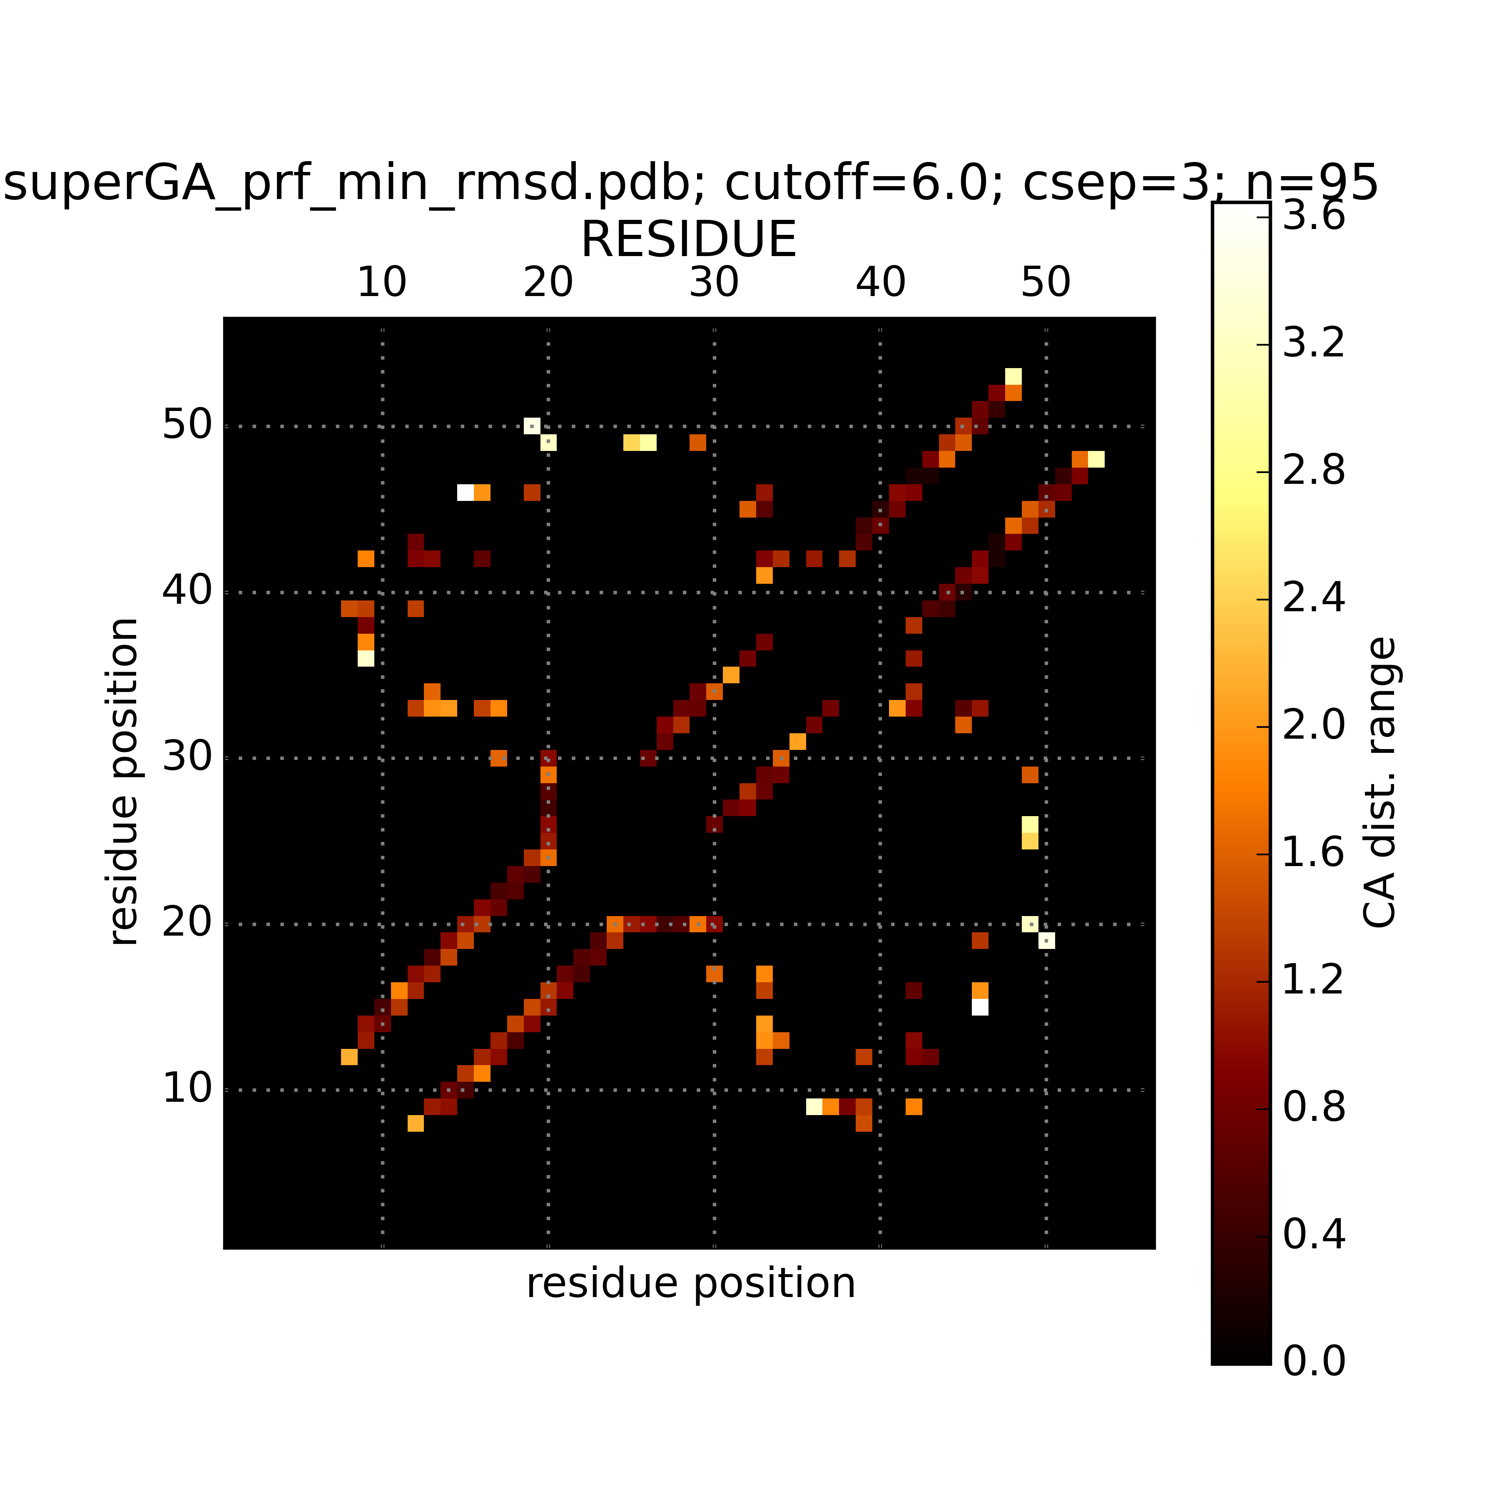
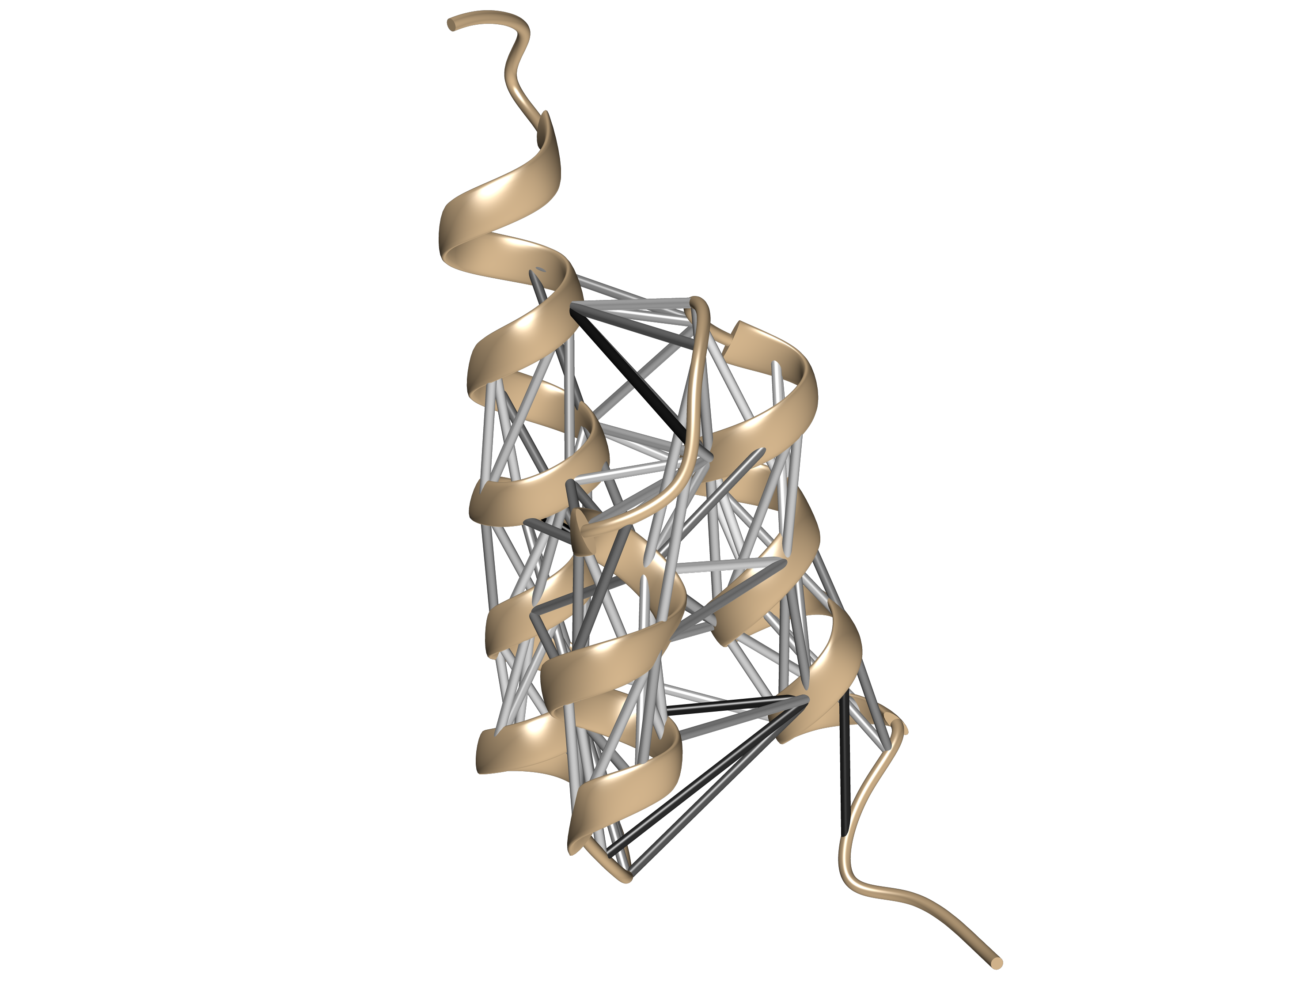
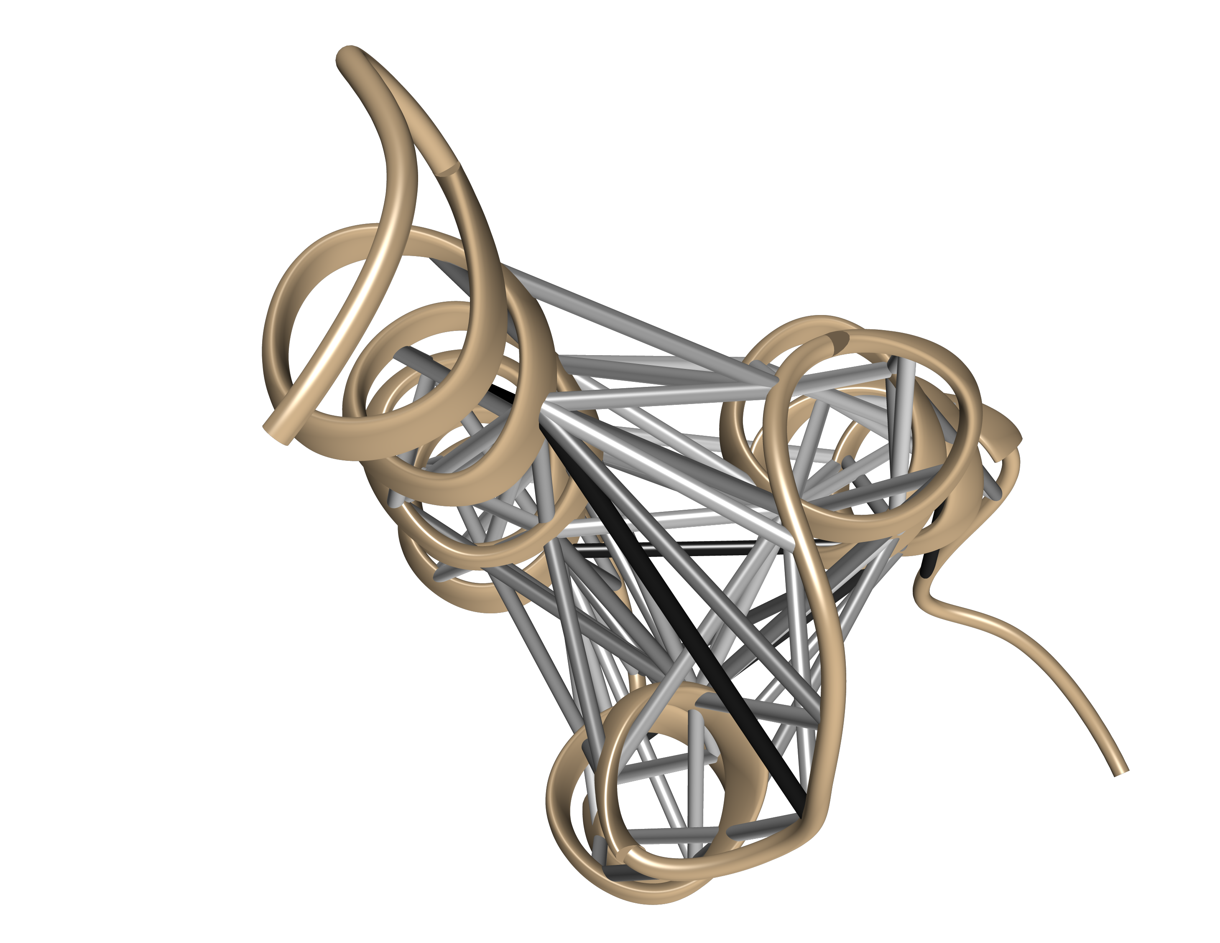
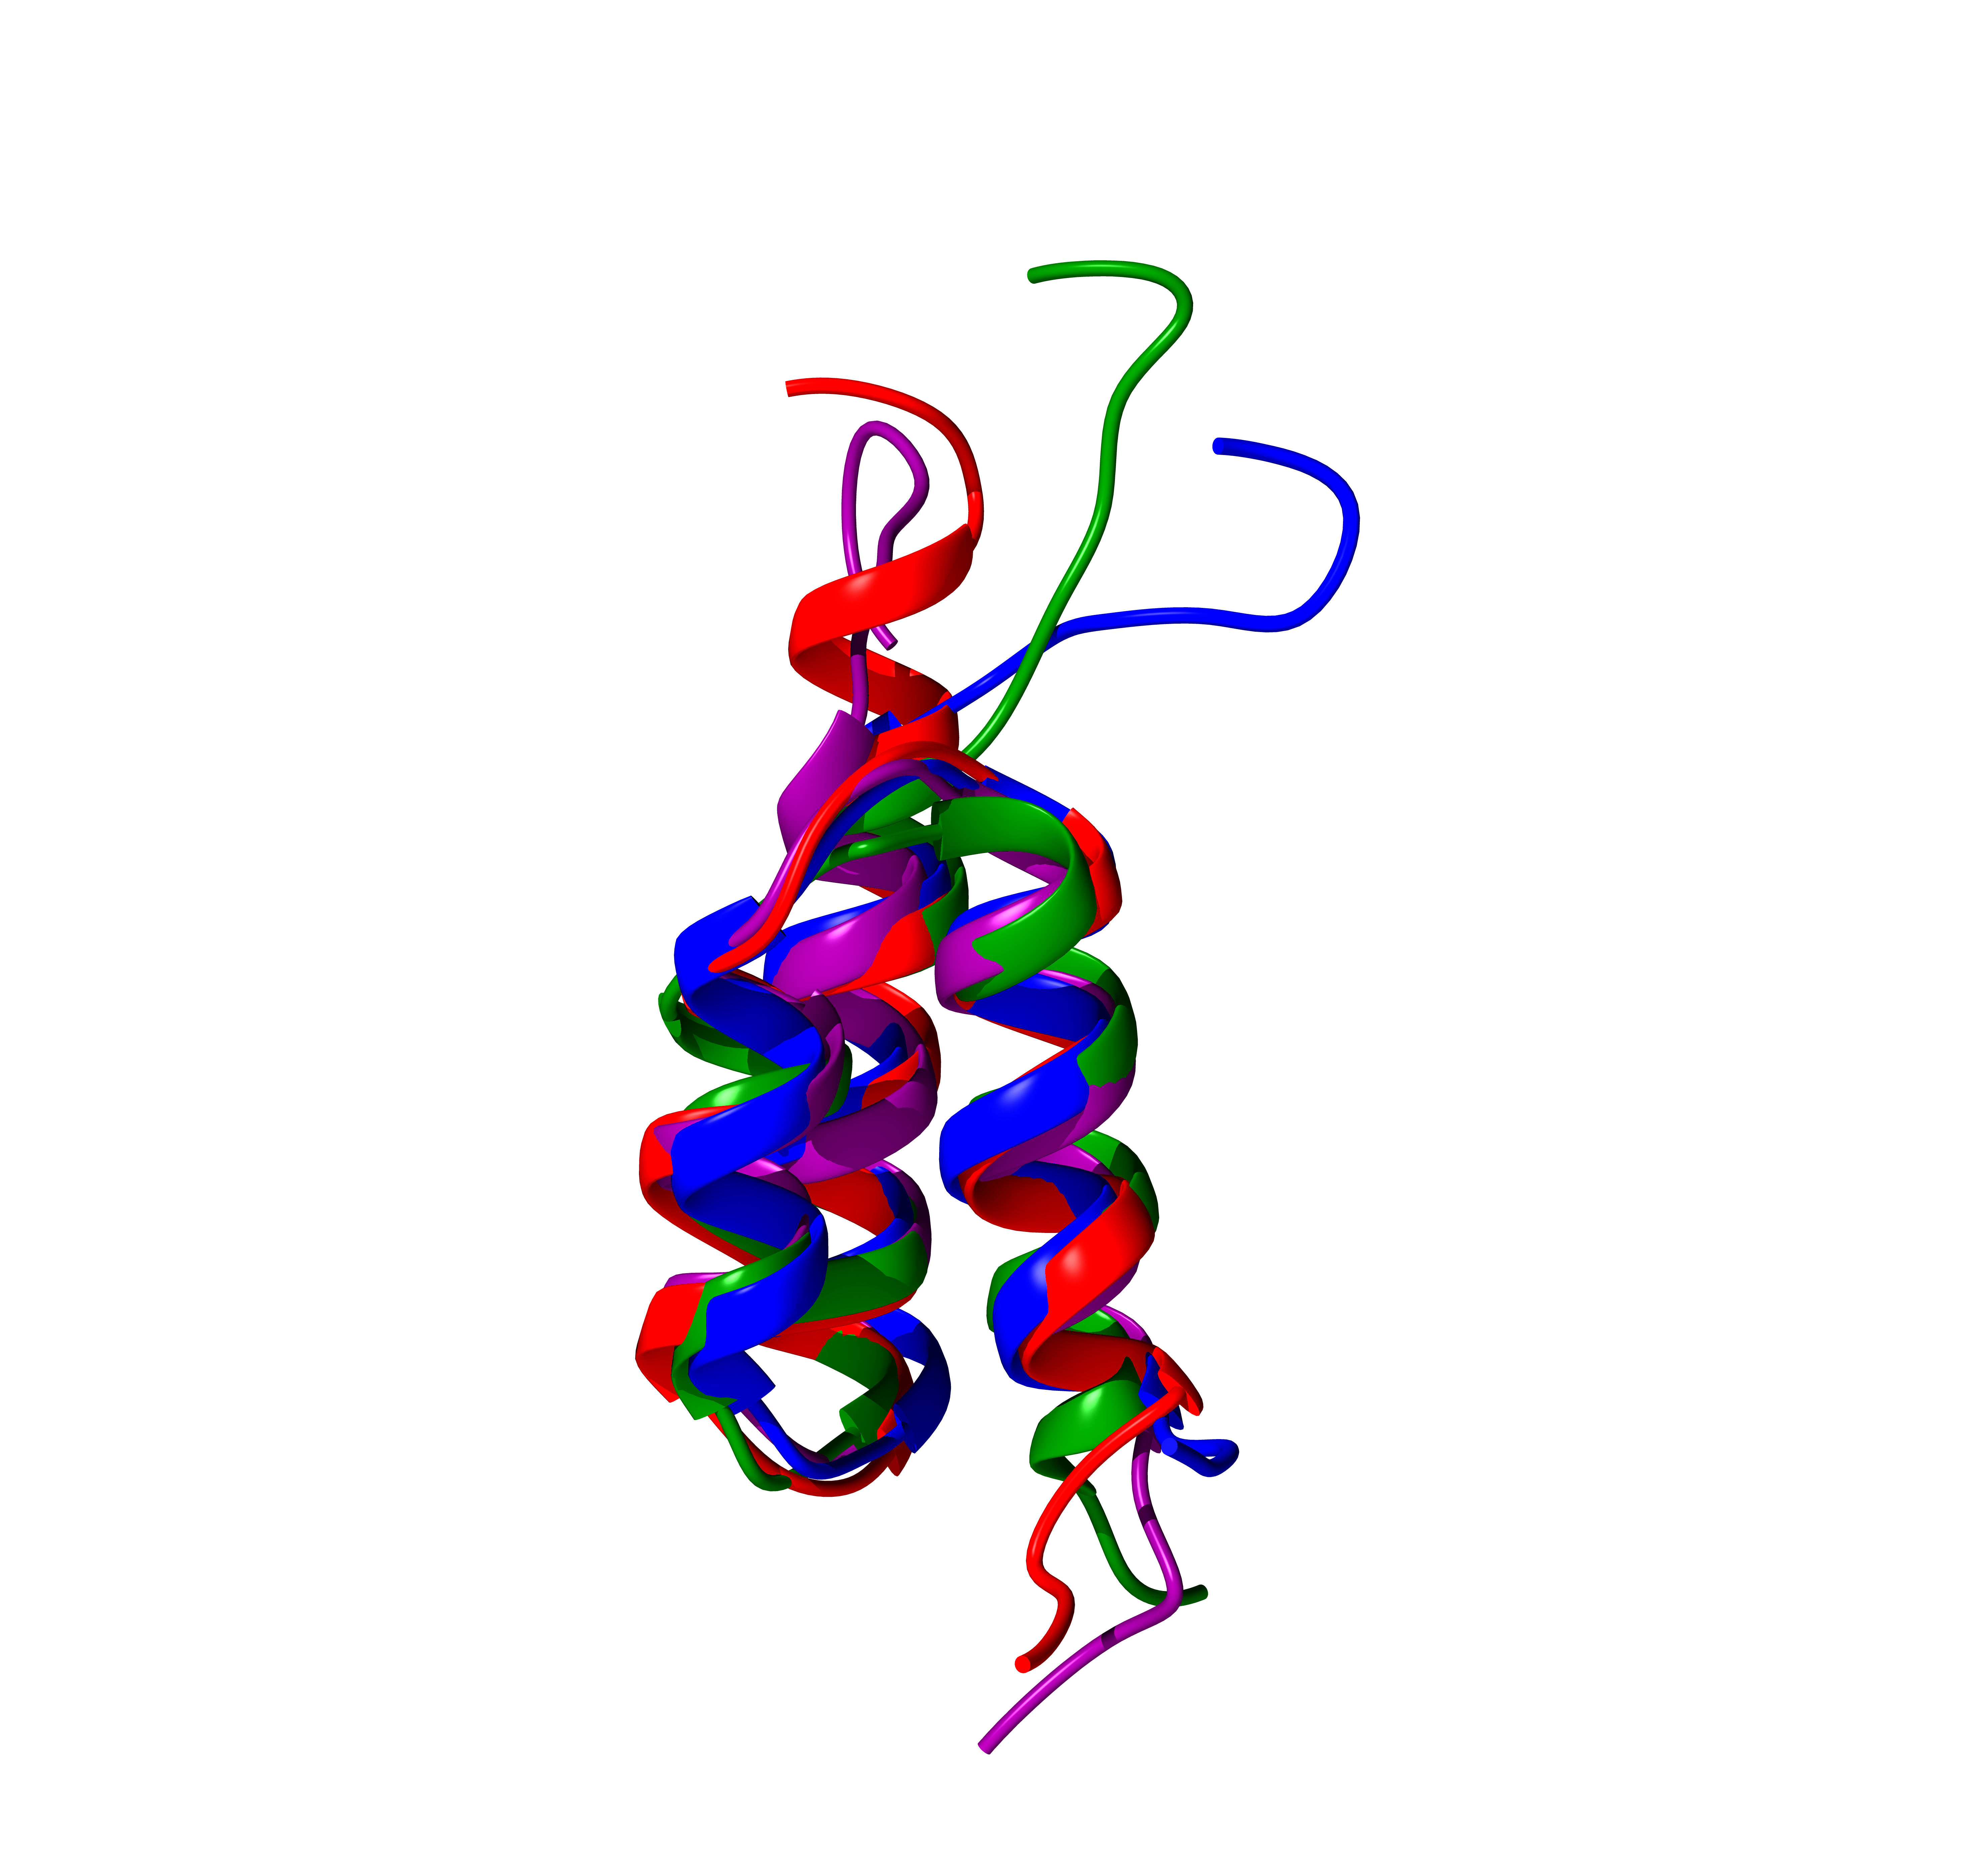
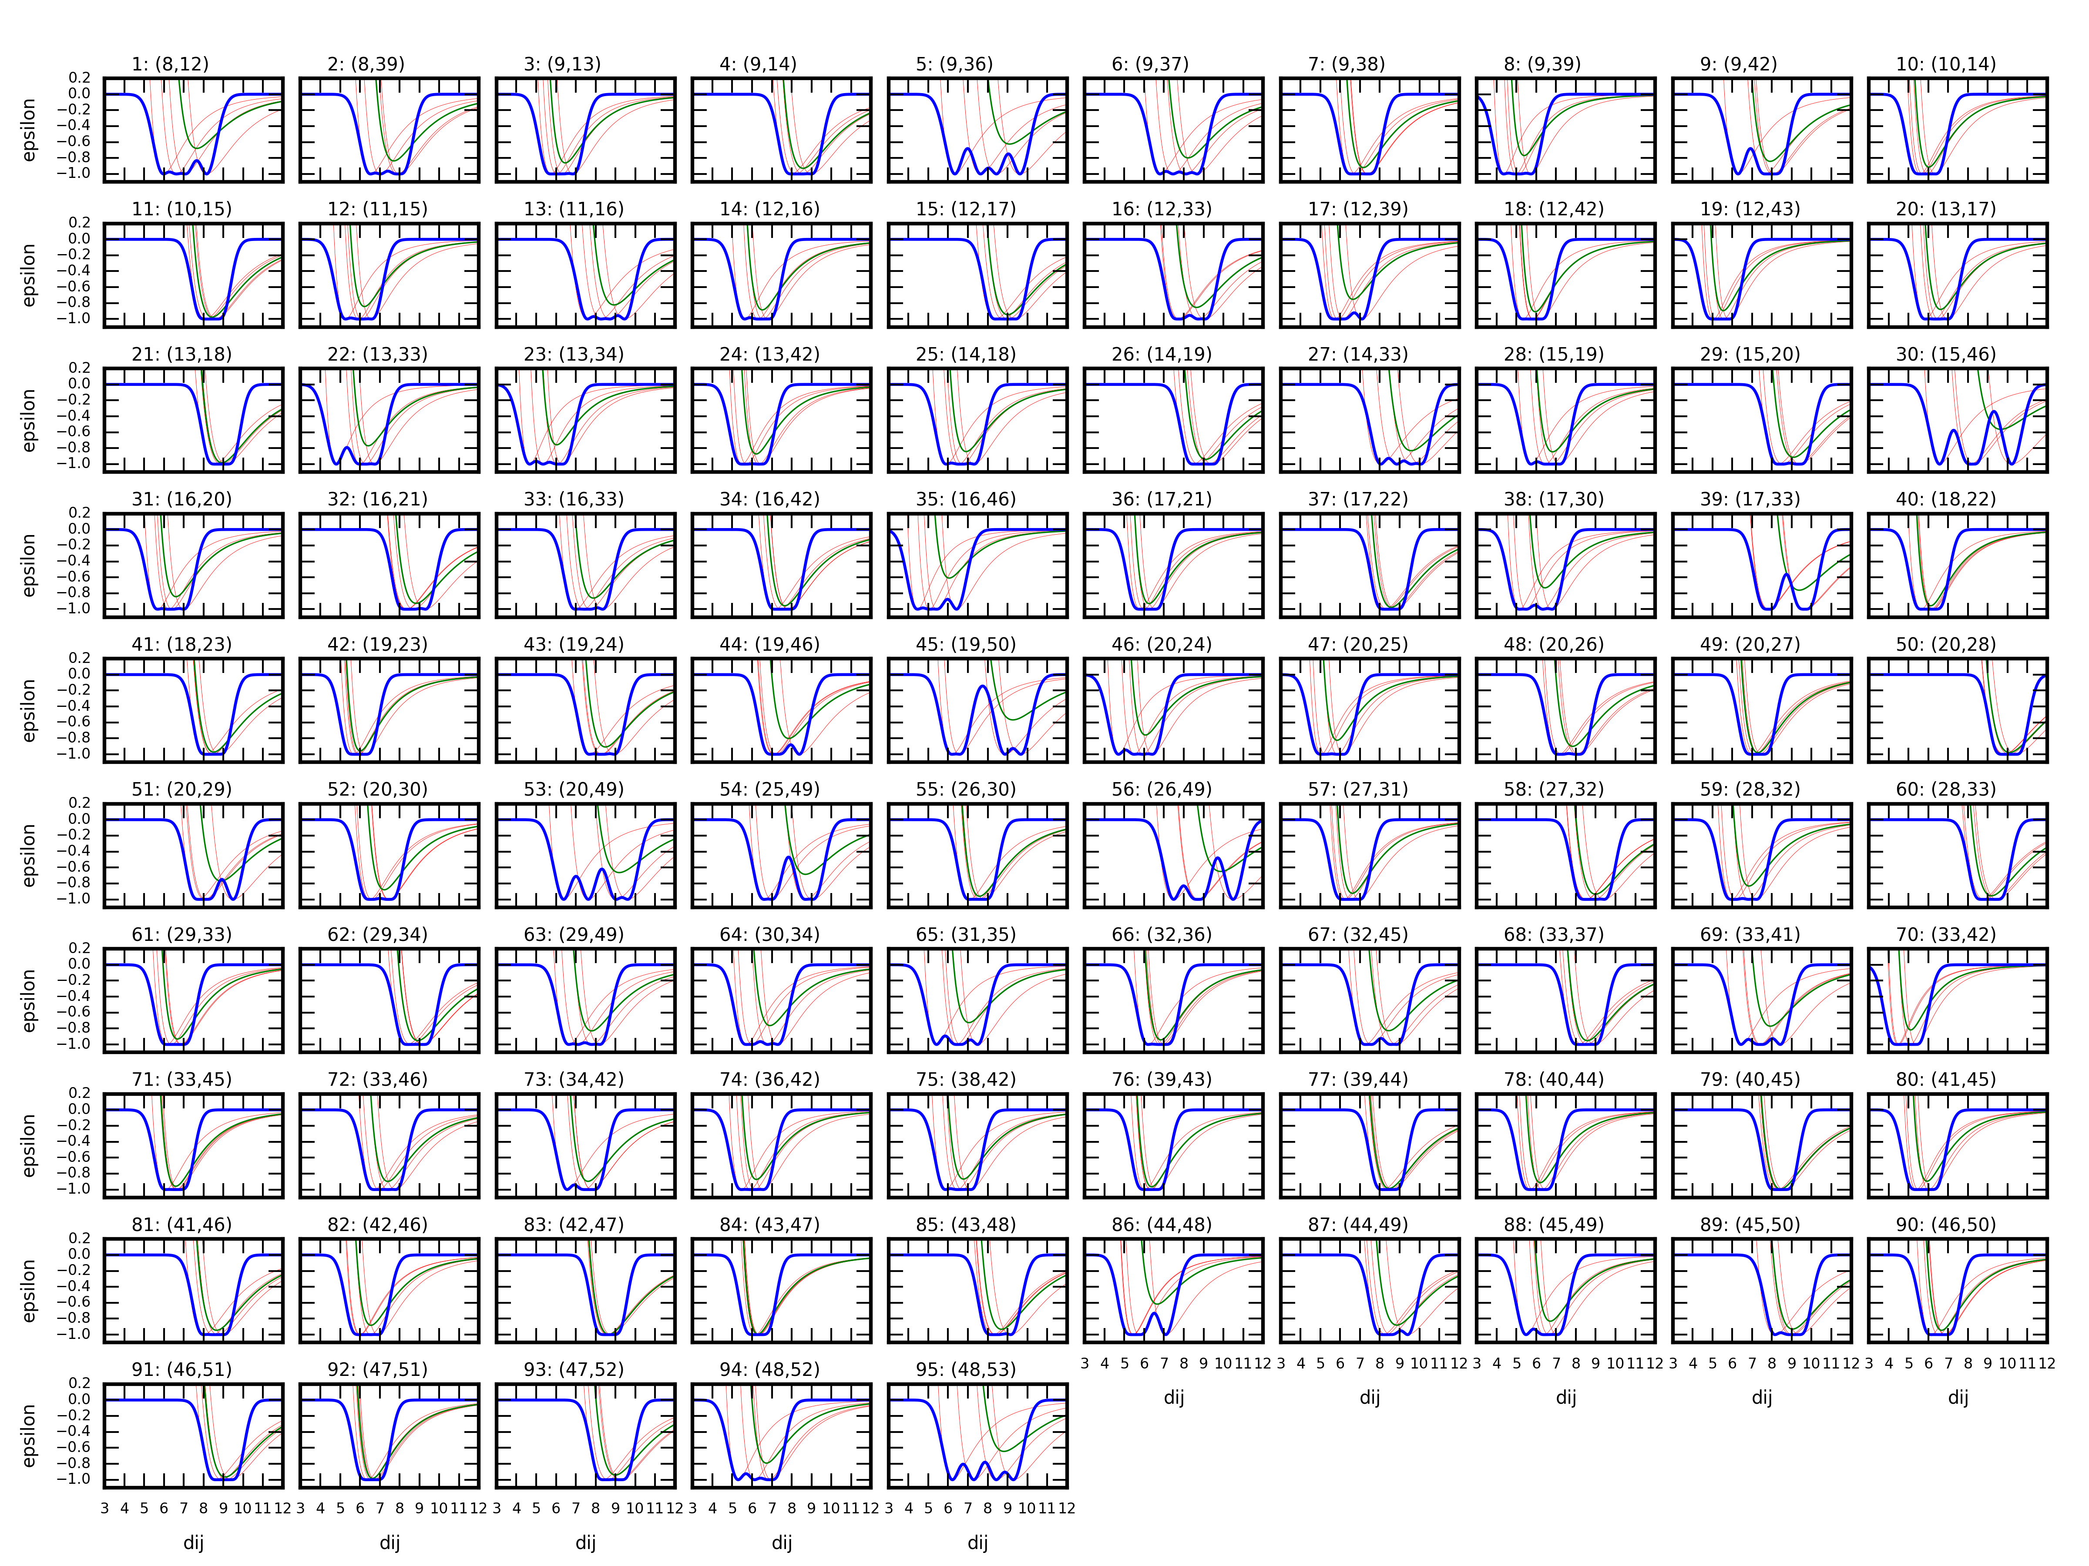
CREATING THE SBM
1) choose PDB codes (same sequence length required)
(e.g. 2FS1, 2JWS, 2KDL, 2LHC)
2) python fetchPDB.py 2FS1
3) python cleanPDB.py 2FS1.pdb
4) python splitPDB.py 2FS1_clean.pdb
5) python aggregatePDB.py superGA.pdb True 2FS1_clean_m1.pdb ...
6) python contactmap.py superGA_prf_min_rmsd.pdb
Output:
.xml → Profasi SBM file
.pseudobonds →UCSF Chimera pseudobonds file
.png → contact map plot
.png.data → raw data plotted in contact map
...multiwell.png → plot of all consensus contacts

Slide 2
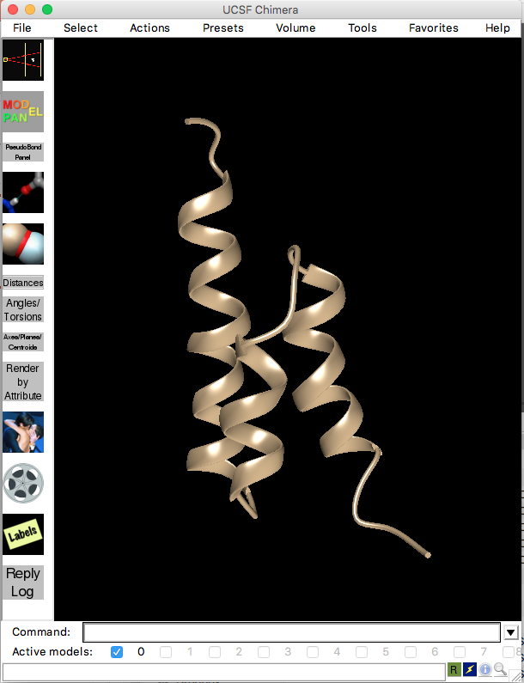
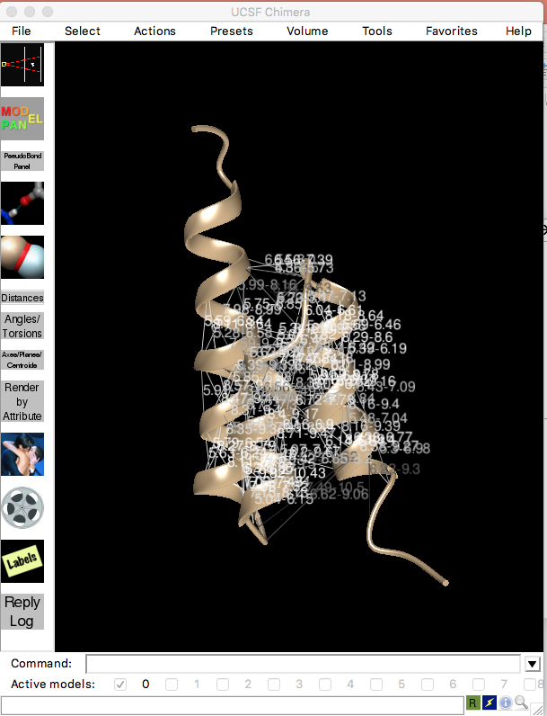
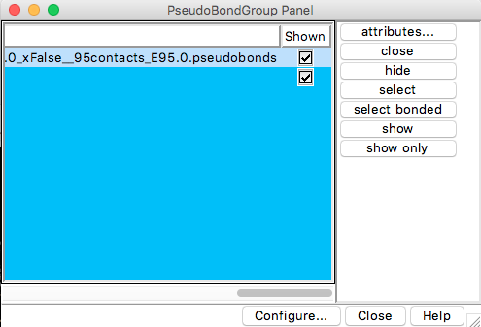
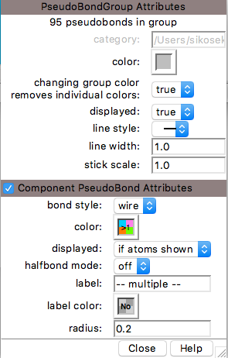
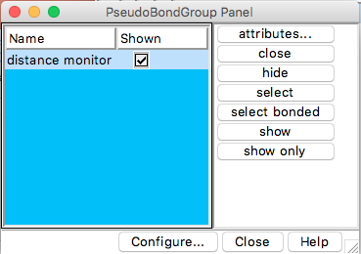
1) File → Open → “2FS1_clean_m1.pdb”
3) Tools → Depiction → PseudoBond Reader → ”superGA.pseudobonds”
increase?
sticks?
2) Tools → General Controls → PseudoBond Panel
remove?

